Slide 1

AI-Powered Phishing & Threat Intelligence Detection System
A Cross-Disciplinary Project Integrating Cybersecurity, AI & Data Science
Team Members:Abhay pratap singh , Ayush mishra , Abhitendra pratap singh , Ayush pandey

Slide 2

The Problem
Phishing's Impact
Detection Challenges
Over 90% of data breaches stem from phishing attacks worldwide.
Rule-based filters fail against adaptive AI-driven social engineering.
Attack Sophistication
Highly personalized phishing tricks evade traditional detection methods.

Slide 3

Our Solution
Real-Time Detection
Intelligent system catches phishing attempts immediately.
Advanced AI Models
NLP models like BERT analyze text context deeply.
Sandbox Simulation
Safe environment tests threats before alerting.
Threat Scoring
Each threat gets a severity and confidence score.

Slide 4
Tech Stack
Languages & Frameworks
AI Models & Data
Security Measures
Python
BERT via HuggingFace
Sandboxed testing environment
FastAPI
PhishTank & SpamAssassin datasets
scikit-learn
Secure API endpoints
Kaggle email collections

Slide 5
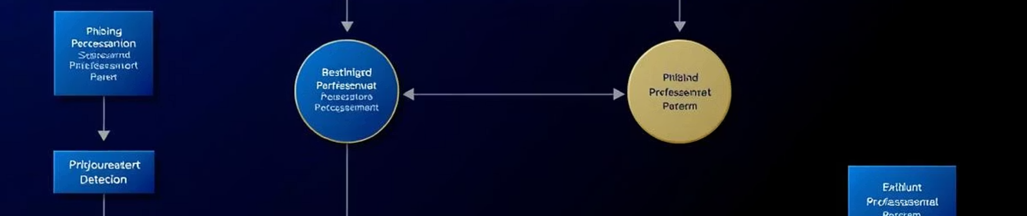
System Architecture
Input (email or URL) → Preprocessing → NLP Model → Threat Scoring → Output (Benign / Phishing)
Modular pipeline enables easy future tool integration.

Slide 6




Core Capabilities
AI-Powered Detection
Secure Sandbox
Threat Scoring
API Integration
Simulates and evaluates suspicious content safely.
Confidence-based scoring engine for precise threat levels.
Seamlessly connects with email clients, browsers, and SOCs.
Real-time phishing detection using BERT-based NLP models.

Slide 7
Competitor Analysis
Tool/Service
Real-Time Detection
AI-Based
Sandbox Simulation
Custom Training
Open Source
Our Project
✅
✅
✅
✅
✅
Google Safe Browsing
✅
❌
❌
❌
❌
Microsoft Defender
✅
✅
❌
❌
❌
VirusTotal
✅
❌
✅
❌
Partial
We aim to offer openness, flexibility, and adaptability for research, enterprise, and education.

Slide 8
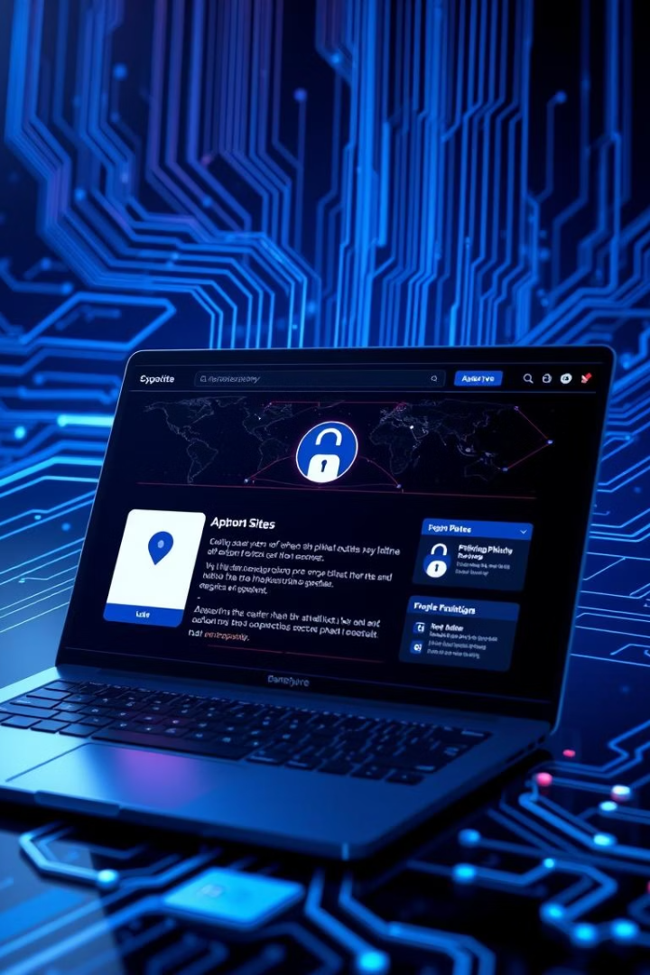
Future Scope
Browser Extension
Real-time phishing alerts during web browsing
Email Security Plugin
Enterprise-grade phishing protection integration
SOC Integration
Automated threat alerts for Security Operations Centers
Simulation Dashboard
Advanced phishing attack simulation and detailed reporting

Slide 9

Thank You!
We welcome your feedback, guidance, and suggestions to advance our system.

